Slide 1
Generative Models for Synthesizing PET Images for Alzheimer Disease
Name: Manish Panda Supervisor's Name: Prof. Kevin Wells
Date: 19/09/2024

Slide 2
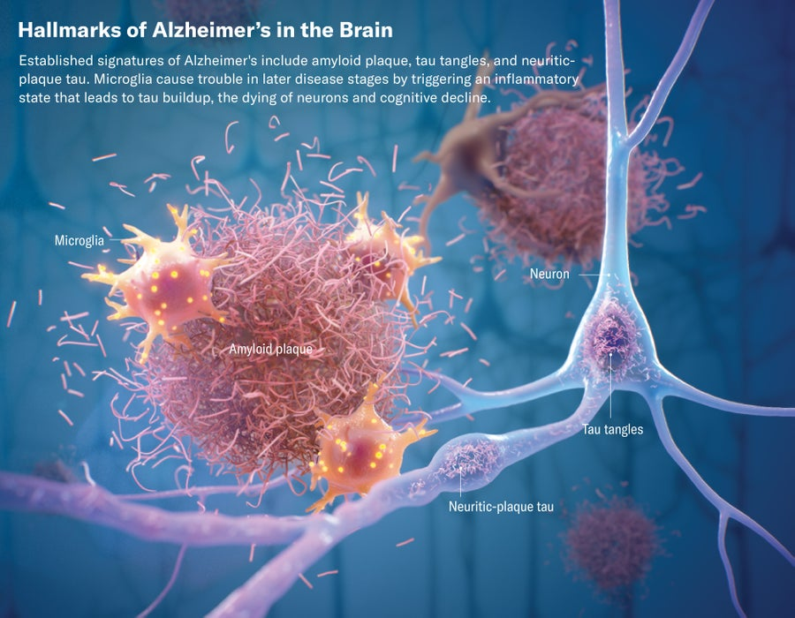
Introduction
Fig: Alzheimer Disease

Slide 3
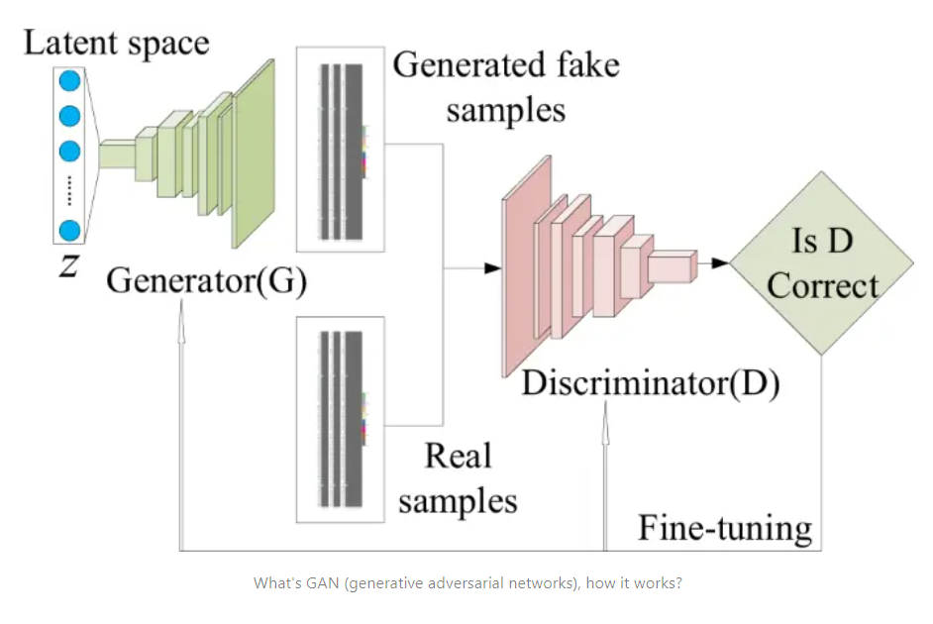
Generative Adversarial Network (GAN)
Fig: Generative Adversarial Network (GAN) Architecture

Slide 4
Objectives
Design and implement GAN architectures suitable for synthesizing PET images.
Fine-tune model hyperparameters to enhance the fidelity and quality of these synthetic images.
Evaluate the synthetic images using quality metrics like Mean Squared Error, or MSE, and the Structural Similarity Index, or SSIM.
Compare these synthetic PET images with actual PET scans to verify their clinical applicability for representing metabolic pathways associated with Alzheimer’s disease.

Slide 5
Literature Review
Imaging Techniques:
CT
MRI
PET
Generative Adversarial Networks (GANs): Proposed by Ian Goodfellow.
Key Developments:
DCGAN (2015): Stability with convolutional layers.
SRGAN (2016): Enhanced image resolution using GANs for realistic upscaling.
Challenges:
Training instability (mode collapse).
Lack of robust evaluation metrics.
Applications:
Image synthesis and enhancement.
Medical imaging and anomaly detection.
Text-to-image and video generation.

Slide 6
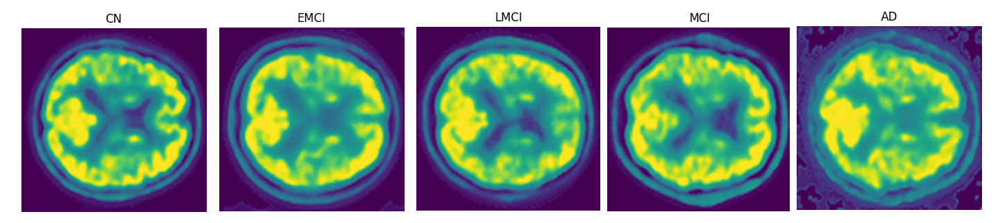
Dataset Preparation
Fig: PET Images categorized by cognitive states

Slide 7
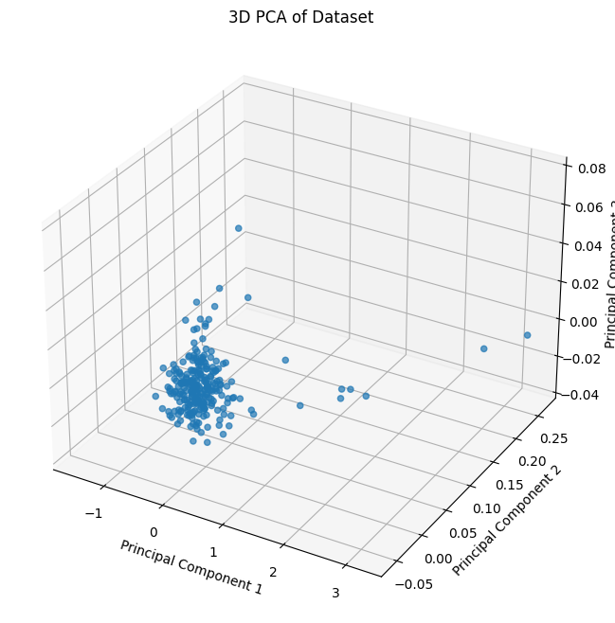
Manifold Learnings
Principal Component Analysis (PCA)

Slide 8
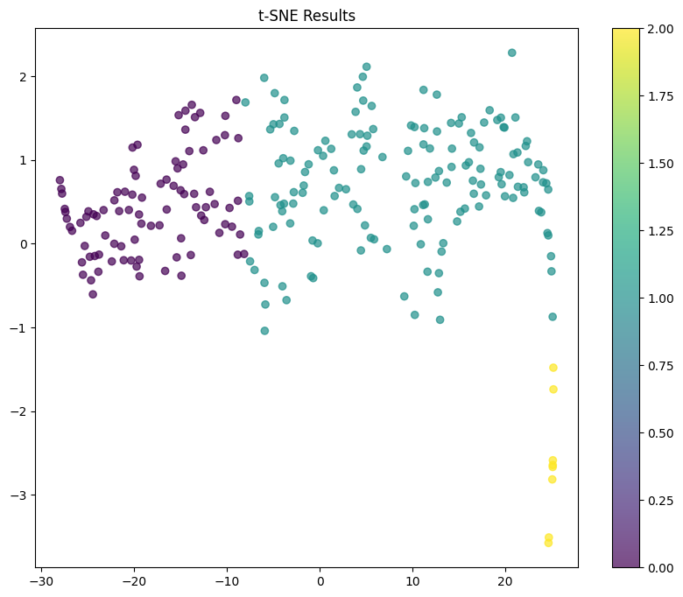
t-Distributed Stochastic Neighbor Embedding(t-SNE)

Slide 9
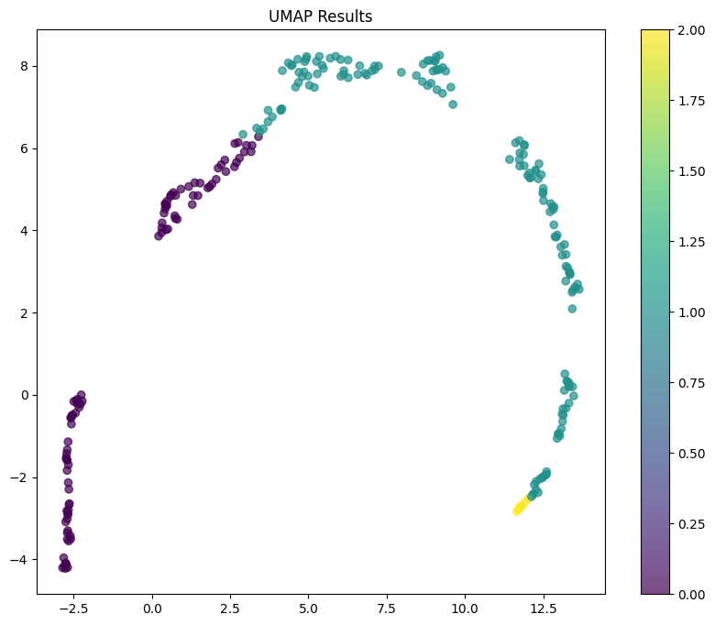
Uniform Manifold Approximation and Projection(Umap)

Slide 10
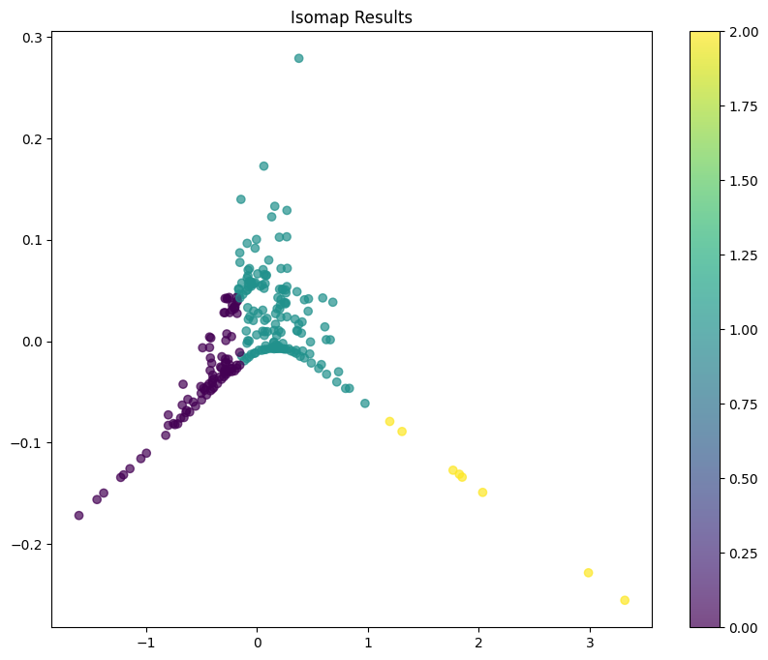
Isometric Mapping(Isomap)

Slide 11
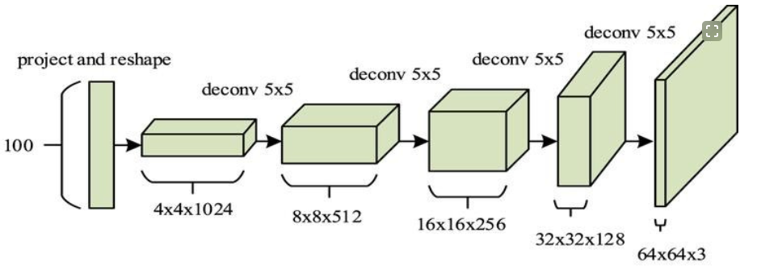
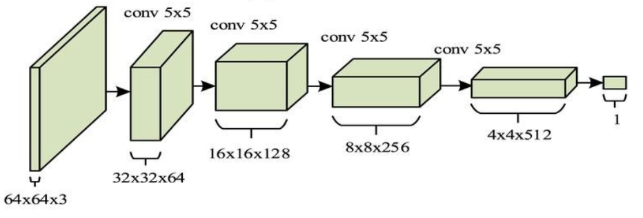
Deep Convolutional Generative Adversarial Network (DCGAN)
GENERATOR
DISCRIMINATOR

Slide 12
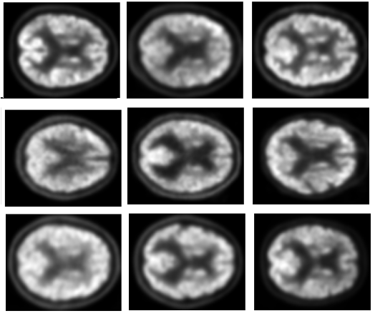
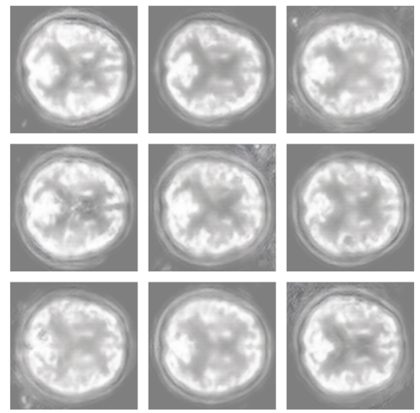
DCGAN Results
REAL IMAGES
GENERATED IMAGES

Slide 13
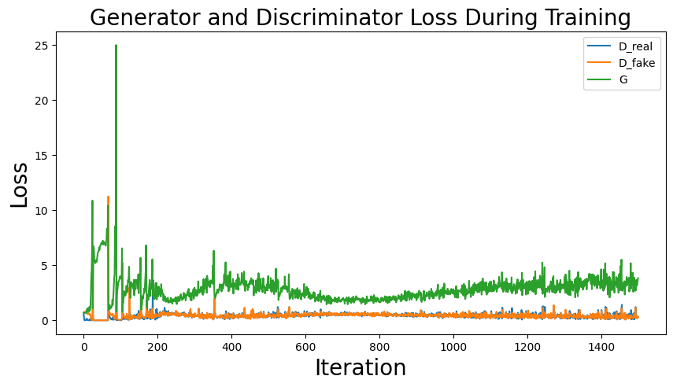
DCGAN Loss Distribution

Slide 14
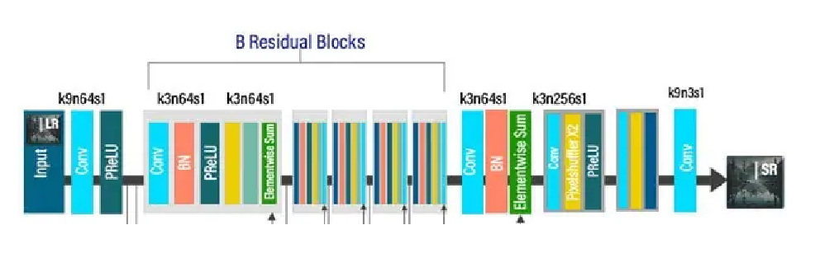
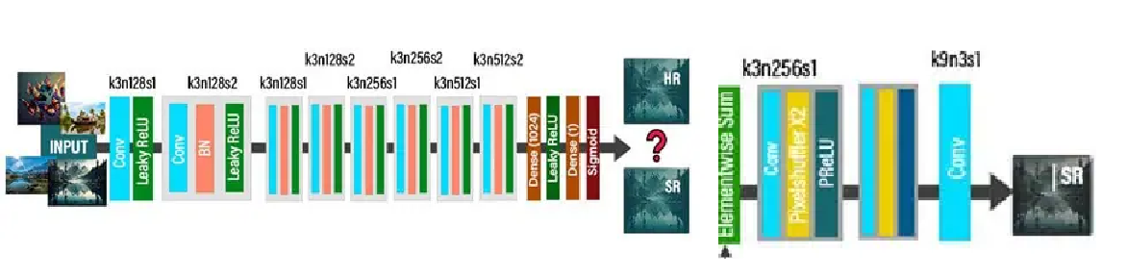
Super Resolution Generative Adversarial Network (SRGAN)
GENERATOR
DISCRIMINATOR

Slide 15
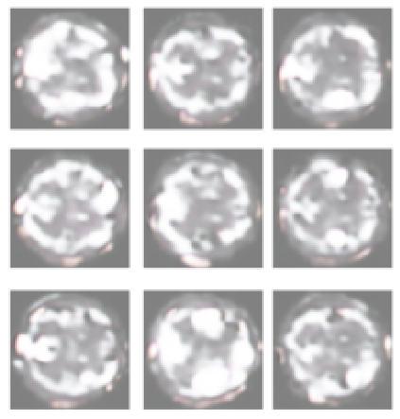
SRGAN Results
REAL IMAGES
GENERATED IMAGES

Slide 16
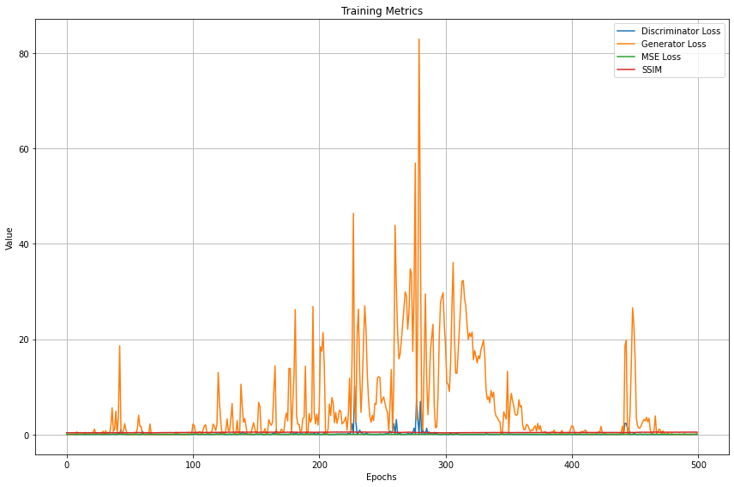
SRGAN Loss Distribution

Slide 17
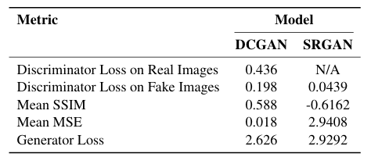
Comparative Analysis

Slide 18
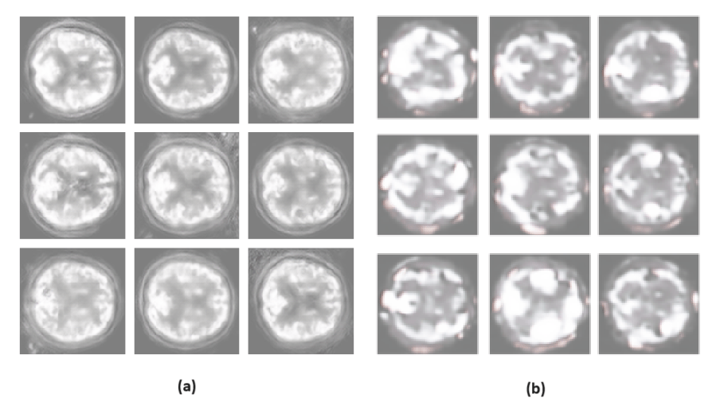
Fig: Comparing generated images: (a)DCGAN (b)SRGAN

Slide 19
Future Work
Future work will focus on enhancing SRGAN’s training dynamics to reduce instability.
Explore alternative architectures:
StyleGAN
CycleGAN
VAEGAN
Integrate multi-modal data:
MRI and CT combined with PET

Slide 20
Conclusion
Effectiveness of DCGAN: DCGAN outperformed SRGAN in generating synthetic PET images with higher clarity and structural integrity, making it more suitable for medical imaging purposes.
Challenges with SRGAN: Although designed for super-resolution tasks, SRGAN faced issues like mode collapse, overfitting, and instability during training, resulting in lower-quality outputs.
Clinical Relevance: The ability to generate high-quality synthetic PET images can potentially reduce the reliance on traditional imaging methods, thereby lowering costs and improving accessibility for early diagnosis of Alzheimer’s disease.

Slide 21
THANK YOU!

